Slide 1
Module 4 – Hypothesis Testing II

Slide 2
Common Hypothesis Tests
Test | Application
one-sample t-test (see module 3) | Compare means of a variable in 1 sample to a number
two-sample t-test | Compare means of a variable in 2 samples
two-sample z-test | Compare proportions (percentages) of a variable in 2 samples
paired t-test | Compare means of a 2 variables using data from the same sample
chi-squared test | Compare the counts for all combinatorial levels of categorical variables

Slide 3
Internet Usage Data
Respondent Number | Sex | Familiarity | Internet Usage | Attitude Toward Internet | Attitude Toward Technology | Usage of Internet: Shopping | Usage of Internet: Banking
1 | 1 | 7 | 14 | 7 | 6 | 1 | 1
2 | 2 | 2 | 2 | 3 | 3 | 2 | 2
3 | 2 | 3 | 3 | 4 | 3 | 1 | 2
4 | 2 | 3 | 3 | 7 | 5 | 1 | 2
5 | 1 | 7 | 13 | 7 | 7 | 1 | 1
6 | 2 | 4 | 6 | 5 | 4 | 1 | 2
7 | 2 | 2 | 2 | 4 | 5 | 2 | 2
8 | 2 | 3 | 6 | 5 | 4 | 2 | 2
9 | 2 | 3 | 6 | 6 | 4 | 1 | 2
10 | 1 | 9 | 15 | 7 | 6 | 1 | 2
11 | 2 | 4 | 3 | 4 | 3 | 2 | 2
12 | 2 | 5 | 4 | 6 | 4 | 2 | 2
13 | 1 | 6 | 9 | 6 | 5 | 2 | 1
14 | 1 | 6 | 8 | 3 | 2 | 2 | 2

Slide 4
Internet Usage Data
Respondent Number | Sex | Familiarity | Internet Usage | Attitude Toward Internet | Attitude Toward Technology | Usage of Internet: Shopping | Usage of Internet: Banking
15 | 1 | 6 | 5 | 5 | 4 | 1 | 2
16 | 2 | 4 | 3 | 4 | 3 | 2 | 2
17 | 1 | 6 | 9 | 5 | 3 | 1 | 1
18 | 1 | 4 | 4 | 5 | 4 | 1 | 2
19 | 1 | 7 | 14 | 6 | 6 | 1 | 1
20 | 2 | 6 | 6 | 6 | 4 | 2 | 2
21 | 1 | 6 | 9 | 4 | 2 | 2 | 2
22 | 1 | 5 | 5 | 5 | 4 | 2 | 1
23 | 2 | 3 | 2 | 4 | 2 | 2 | 2
24 | 1 | 7 | 15 | 6 | 6 | 1 | 1
25 | 2 | 6 | 6 | 5 | 3 | 1 | 2
26 | 1 | 6 | 13 | 6 | 6 | 1 | 1
27 | 2 | 5 | 4 | 5 | 5 | 1 | 1
28 | 2 | 4 | 2 | 3 | 2 | 2 | 2
29 | 1 | 4 | 4 | 5 | 3 | 1 | 2
30 | 1 | 3 | 3 | 7 | 5 | 1 | 2

Slide 5
Two Sample T-Test for Means
Purpose:
Many data analytics questions explore compare average values of a variable in two populations
Examples:
Do users and nonusers of a brand differ in terms of their perceptions of the brand?
Do high-income consumers spend more on entertainment than low-income consumers?

Slide 6
Two Sample T-Test for Means
State the null and alternative hypotheses.
Null hypothesis, H₀: Mean of a variable in sample 1 = Mean of a variable in sample 2
Alternate hypothesis, H_{a}: Mean of a variable in sample 1 ≠ Mean of a variable in sample 2
Choose a level of confidence. Use p-value to decide whether to reject null hypothesis.
If we use level of confidence of 95%:
p-value < 0.05 -> Reject H₀
p-value > 0.05 -> Do not reject H₀

Slide 7
Example: Two Sample T-Test for Means
Suppose we wanted to use two-sample t-test to decide whether mean Internet usage is different for males compared to females. A significance level of a = 0.05 (confidence level of 95%) is selected.
State the null and alternative hypotheses:
H₀: Mean of Internet Usage for males = Mean of Internet Usage for females
H_{a}: Mean of Internet Usage for males ≠ Mean of Internet Usage for females
p-vlaue ~ 0 < 0.05
Reject H₀ that Internet usage is same for males and females
Conclude that Internet usage is different for males and females

Slide 8
Two Sample Z-Test for Proportions
Purpose:
Find whether 2 proportions (percentages) are equal
Examples:
Is the proportion of respondents using the Internet for shopping the same for males and females?
Is the proportion of respondents familiar with data privacy the same for males and females?
Is the proportion of male customers the same for Uber and Lyft?

Slide 9
Two Sample Z-Test for Proportions
State the null and alternative hypotheses
Null hypothesis, H₀: Proportion of a variable in sample 1 = Proportion of a variable in sample 2
Alternate hypothesis, H_{a}: Proportion of a variable in sample 1 ≠ Proportion of a variable in sample 2
Choose a level of confidence. Use p-value to decide whether to reject null hypothesis
If we use level of confidence of 95%:
p-value < 0.05 -> Reject H₀
p-value > 0.05 -> Do not reject H₀

Slide 10
Example: Two Sample Z-Test for Proportions
Suppose we wanted to find whether the proportion of respondents using the Internet for shopping the same for males and females. A confidence level of 95% is selected.
State the null and alternative hypotheses:
H₀: Proportion of male Internet shoppers = Proportion of female Internet shoppers
H_{a}: Proportion of male Internet shoppers ≠ Proportion of female Internet shoppers
p-value = 0.065 > 0.05. Do not reject null hypothesis that proportion of male Internet shoppers = proportion of female Internet shoppers

Slide 11
Paired T-Test for Two Samples
Purpose:
In many data analytics applications, we often need to compare answers to different questions from the same respondents
Example:
A sample of respondents may rate two competing brands, indicate the relative importance of two attributes of a product, or evaluate a brand at two different times.

Slide 12
Paired T-Test for Two Samples
State the null and alternative hypotheses
Null hypothesis, H₀: Difference between means of 2 variables from same respondents = 0
Alternate hypothesis, H_{a}: Difference between means of 2 variables from same respondents ≠ 0
Choose a level of confidence. Use p-value to decide whether to reject null hypothesis.
If we use confidence interval of 95%:
p-value < 0.05 -> Reject H₀
p-value > 0.05 -> Do not reject H₀

Slide 13
Example: Paired T-Test for Two Samples
Suppose we wanted to find whether the respondents differ in their attitude toward the Internet and attitude toward technology. A significance level of a = 0.05 (confidence level of 95%) is selected.
State the null and alternative hypotheses:
H₀: There is no difference between mean attitude toward the Internet and technology
H_{a}: There is a difference between mean attitude toward the Internet and technology
p-value ~ 0 < 0.05
Reject H₀ that there is no difference between mean attitude toward the Internet and technology. Conclude that there is a difference between mean attitude toward the Internet and technology.

Slide 14
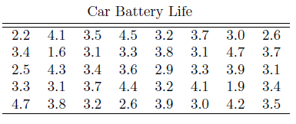
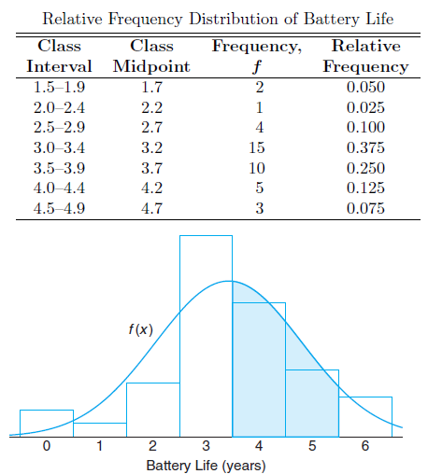
Frequency Distribution
A frequency distribution shows the distribution of values for one variable.
The frequencies can be used to construct a histogram.

Slide 16
Two-Way Table
While a frequency distribution describes one variable at a time, a two-way table (cross-tabulation) describes 2 categorical variables (with 2 or more categories) simultaneously by showing the joint distribution.
e.g. The following two-way table shows the percentages of students completing a bachelor’s degree within 6 years by race/ethnicity:
Race/ Ethnicity | White | Black | Hispanic | Asian | American Indian/ Alaska Native | Two or more races | Total
Graduated | 6963 | 1063 | 1388 | 792 | 69 | 175 | 10,450
Did not graduate | 3933 | 1614 | 1163 | 295 | 110 | 119 | 7234
Total | 10,896 | 2667 | 2551 | 1087 | 179 | 294 | 17,684

Slide 17
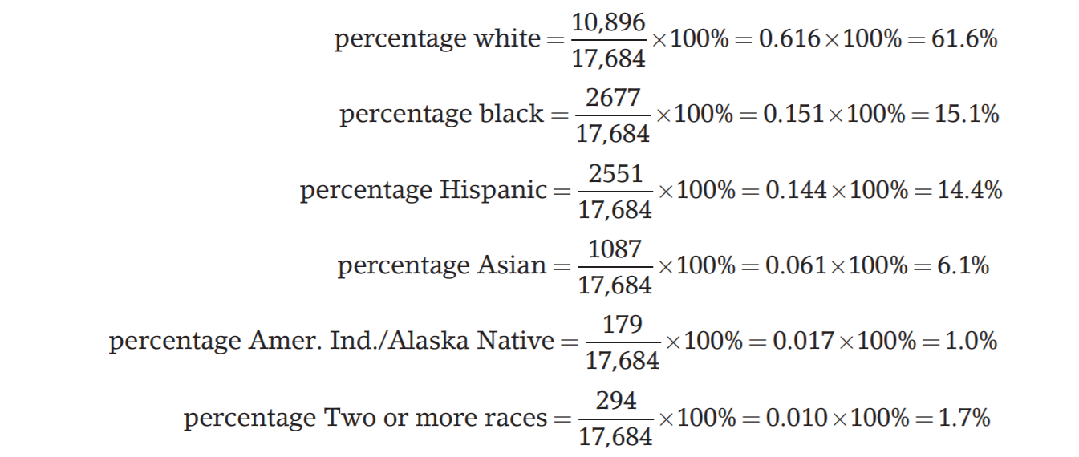
Two-Way Table
Percentages can be calculated for each category of either categorical variable. e.g. We can report the distribution of race as:

Slide 18
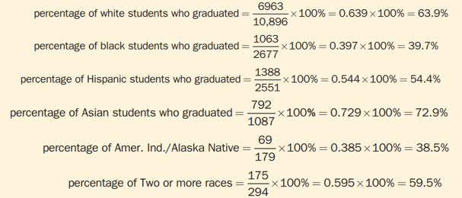
Two-Way Table
We can see the relationship between race and graduation status by comparing the percentages of those who completed a bachelor’s degree within 6 years for each race:

Slide 19
Inference for a Two-Way Table
To decide whether the association in the sample is evidence of an association between these variables in the entire population, we need to conduct a hypothesis test.
This hypothesis test is called a chi-squared test.
Idea: Compare the observed counts in the data to the expected counts.
If the difference is large enough, we conclude that there is a statistically significant association between the variables.

Slide 20
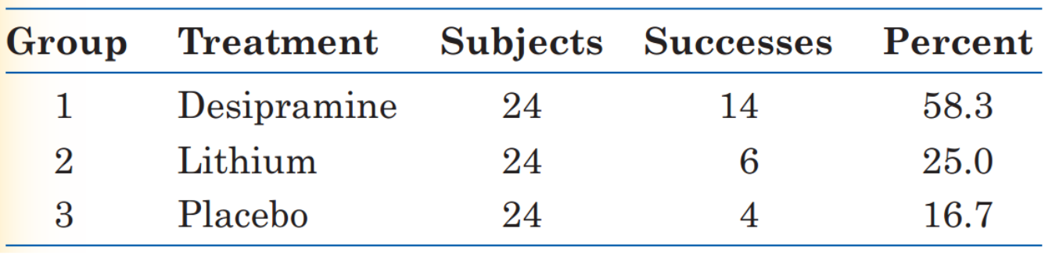
Case: Treating Cocaine Addiction
Cocaine addicts need the drug to feel pleasure. Perhaps, giving them a medication that fights depression will help them resist cocaine.
The subjects were 72 chronic users of cocaine who wanted to break their drug habit. An equal number of the subjects were randomly assigned to each treatment.

Slide 21
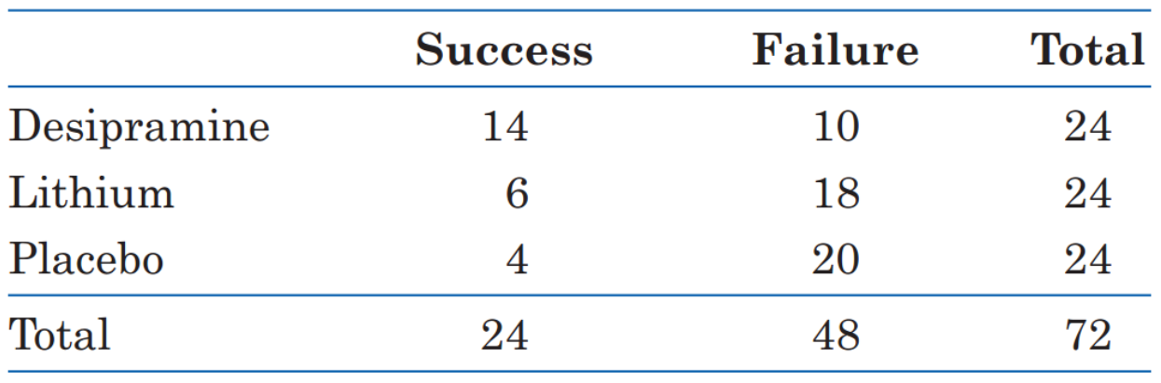
Chi-Squared Test
To conduct the chi-squared test, we first organize the data into a two-way table (cross-tabulation). The 2 categorical variables are treatment and outcome.
Our null hypothesis, as usual, says that the treatments have no effect.
That is, addicts do equally well on any of the 3 treatments. The differences in the sample are just the result of chance.

Slide 22
Chi-Squared Test
The null hypothesis is:
H₀: There is no association between the treatment an addict receives and whether or not there is success in not using cocaine in the population of all cocaine addicts.
The alternative hypothesis is:
H_{a}: There is an association between the treatment an addict receives and whether or not there is success in not using cocaine in the population of all cocaine addicts.

Slide 23
Chi-Squared Test
To test H₀, we compare the observed counts (the data) in the two-way table with the expected counts (calculated from probability theory).
The expected counts are what we would expect if H₀ were true. If the observed counts are far from the expected counts, that is evidence against H₀.
Overall, 24 of the 72 subjects succeeded, which is a success rate of one-third.
If the null hypothesis is true, there is no difference among the treatments. i.e. We expect one-third (8 of 24 people) in each group to succeed.

Slide 24
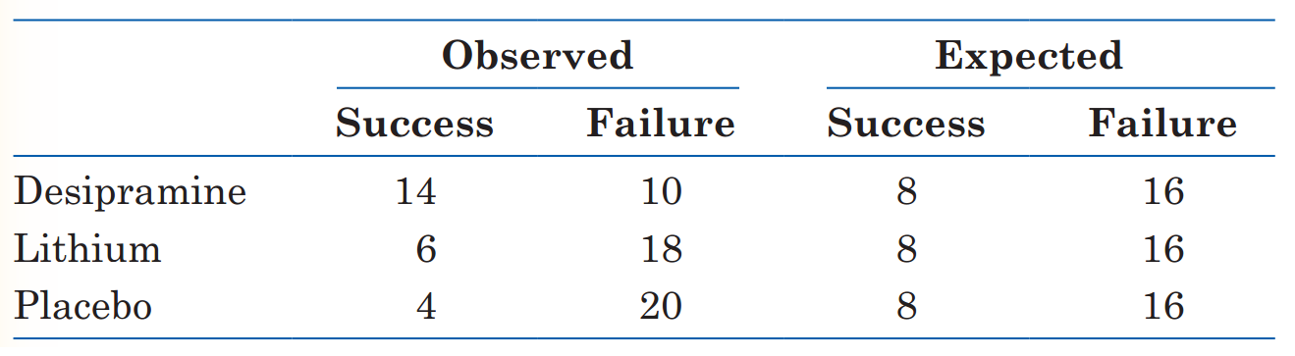
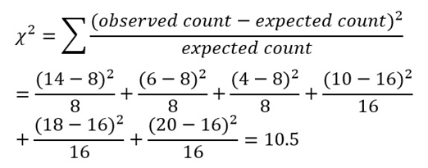
Chi-Squared Test
The chi-squared (χ²) statistic is the sum of the squared differences between the observed and expected counts for each combination of variables (treatment and outcome) divided by the expected count.

Slide 25
Chi-Squared Test
The chi-squared (χ²) statistic is 10.5.
The chi-squared test uses the chi-squared distribution instead of normal distribution.
To see whether this is a large value to provide evidence against the null hypothesis, we need to compare the test statistic to some critical values at particular significance levels α (the p-value is can also be used to decide whether to reject the null hypothesis).
e.g. The p-value is 0.005. We reject the null hypothesis because we have strong evidence of a statistically significant association between the treatment and outcome of cocaine resistance.

Slide 26
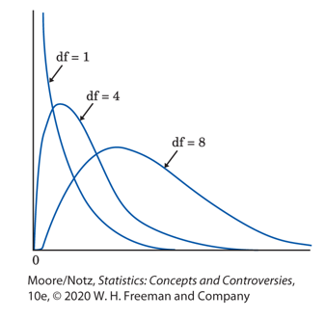
Chi-Squared Distribution
The chi-squared distribution differs for each value of df (degree of freedom).
df = (r – 1) x (c – 1)
r = # of rows in the two-way table (# of categories for the variable on the y-axis)
c = # of columns in the two-way table (# of categories for the variable on the x-axis)

Slide 27
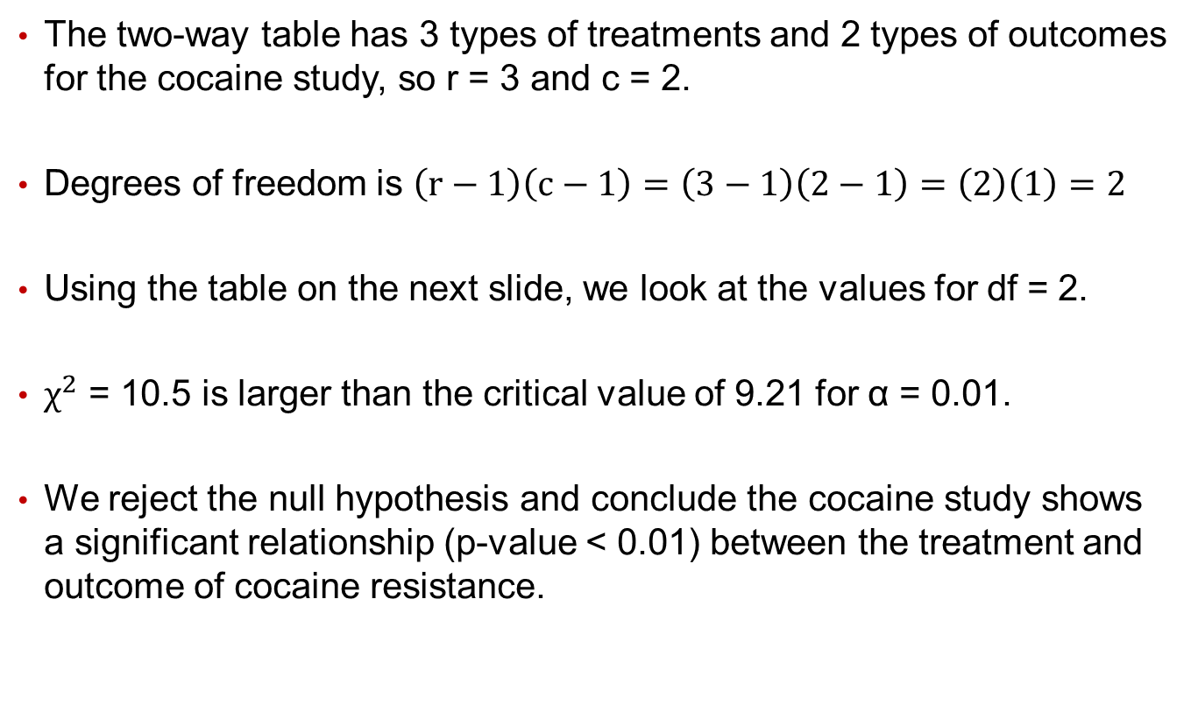
Chi-Squared Test
The two-way table has 3 types of treatments and 2 types of outcomes for the cocaine study, so r = 3 and c = 2.
Degrees of freedom is $\left(r−1\right)\left(c−1\right)=\left(3−1\right)\left(2−1\right)=\left(2\right)\left(1\right)=2$
Using the table on the next slide, we look at the values for df = 2.
$χ^{2}$ = 10.5 is larger than the critical value of 9.21 for α = 0.01.
We reject the null hypothesis and conclude the cocaine study shows a significant relationship (p-value < 0.01) between the treatment and outcome of cocaine resistance.

Slide 28
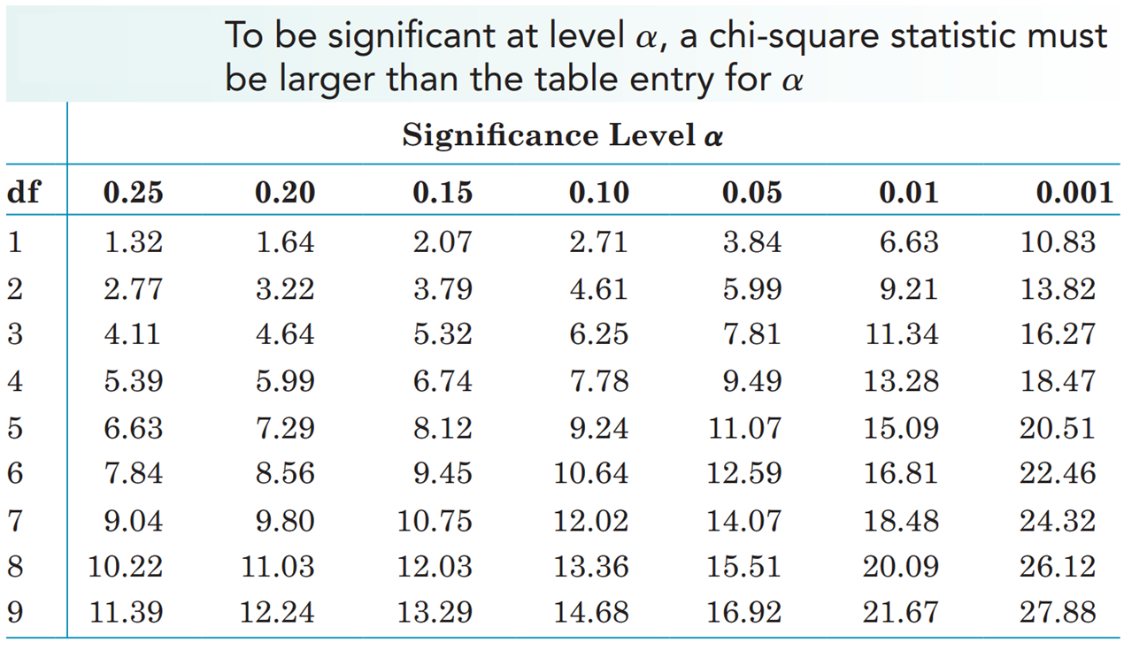
Case: Treating Cocaine Addiction

